Slide 1
Webinar AER Accreditation
March 10, 2020
Angela Smith
Eileen Siffermann
Revised 2023

Slide 2
Introduction
ACCREDITATION COUNCIL
Purpose: To accredit organizations including specialized schools providing direct services to individuals who are blind and those with low vision; and higher education preparation programs in the disciplines that prepare teachers and practitioners working with children and adults who are blind and those with low vision. The Accreditation Council shall have complete autonomy in establishing, approving and administering standards to evaluate these entities; developing and implementing policies, regulations, and procedures for conducting accreditation reviews; making accreditation decisions; and administering an appeal process.
AER Bylaws Approved July 28, 2018
Notes:
Angela

Slide 3
History of Accreditation within the Field of Visual Impairment
1. 1962 AD Hoc Committee on Accreditation was appointed by the American Foundation for the Blind.
2. 1963 an autonomous commission was established that would be responsible for both the development of standards and the creation of a permanent accrediting body. Thus, was born the independent organism known as COMSTAC: The Commission Standards and Accreditation of Services for the Blind.
3. 1967 COMSTAC Report called for the establishment of the National Accreditation Council for Agencies Serving the Blind and Visually Handicapped NAC.
4. 2017 AER assumed the accreditation program previously managed by the National Accreditation Council for Blind and Low Vision Services (NAC)
5. 2018 the AER membership approved an amendment to the AER Bylaws which gave the AER Accreditation Council legal and functioning authority.
Notes:
Eileen

Slide 4
Primary Responsibilities of the AER Accreditation Council
The primary responsibilities of the Council include:
Approve and or deny accreditation.
Define standards and criteria for evaluation of entities and programs and assure compliance to the standards.
Develop methods for measuring the effectiveness of standards and the accreditation process.
Establish guidelines and policies applicable to the accreditation and approval process.
Hear and decide appeals related to the denial of full accreditation.
Establish the re-evaluation of standards cycle and make improvements to the standards as needed.

Slide 5
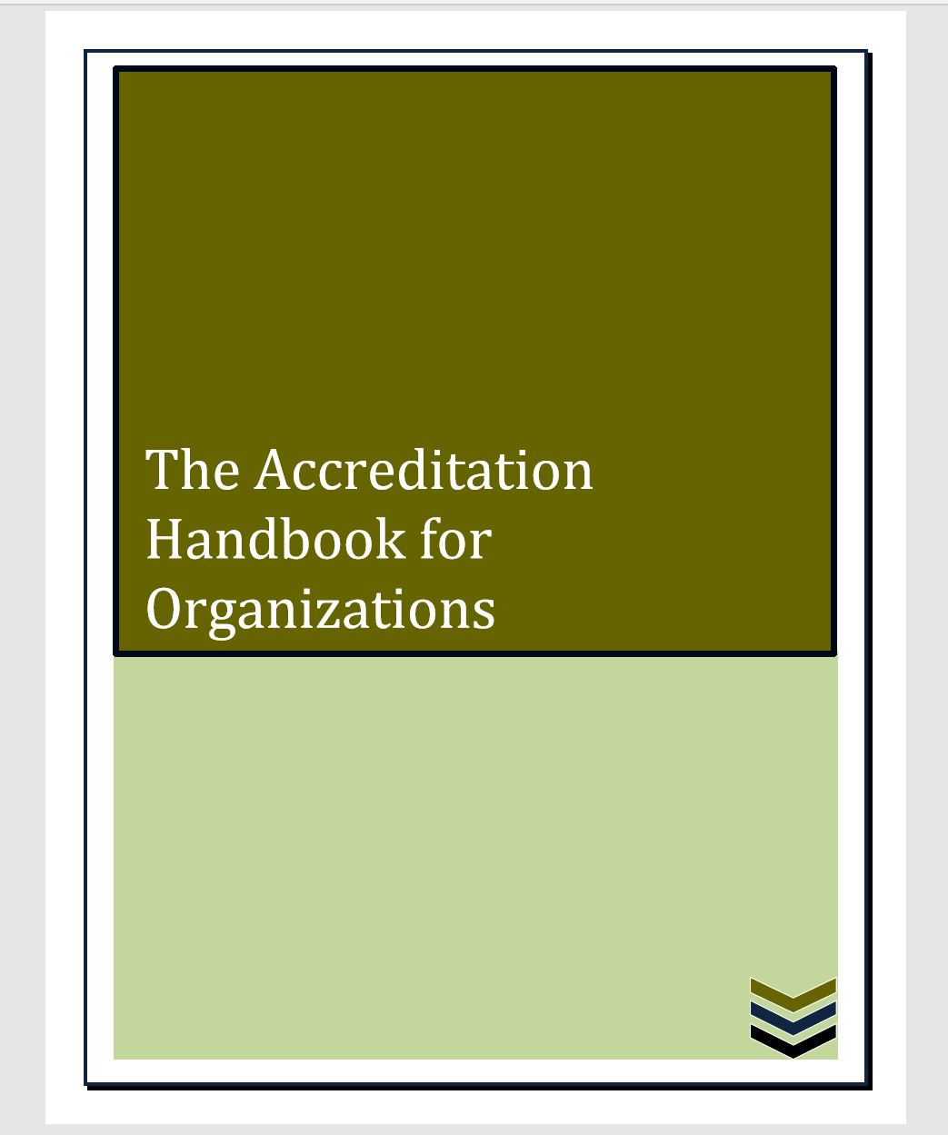
Standards and Process for Organizations and Specialized Schools

Slide 6
Management Standards
All Management Standards are Absolute standards. 100% compliance is required by all organizations applying for accreditation.
Policy and Administration (PA)
Financial Management (FM)
Staff and Volunteers (SV)
Buildings and Grounds (BG)
Community Relations, Public Education & Fundraising (CRPEF)
Community and Consumer Involvement (CCI)
Program Evaluation and Improvement (PEI)

Slide 7
Program Standards
The organization selects the programs for which it is seeking accreditation.
Program Standards – All Ages
Orientation and Mobility Instruction Services (OMIS)
Assistive Technology (AT)
Vision Rehabilitation Therapy (VRT)
Vocational and Rehabilitation Counseling (VRC)
Low Vision Clinic Services (LVCS)
Recreation Program (RP)
Residential Facilities and Health Care (RFHC)

Slide 8
Program Standards – All Ages, continued
Itinerant Services (IP)
Short Term (STP) and Support Services Programs (SSP)
Community Integration Services (CIS)
Outreach Services (OS).
Provision of Reading Materials (PRM)
Blindness Prevention (BP)
Industries Employment Services (IES)

Slide 9
Program Standards – Birth Through School Age
Early Intervention Programs (EIP)
Preschool Programs (PP)
K-12 Programs (K-12)
Supplemental Learning Curriculum (SLC)
Multiple Disabilities Programs (MDP)
Identification and Referral (IR)
Assessment of Need (AN)
Program Design (PD)

Slide 10
Self Study and Document Preparation
Once the organization determines for which programs it will be seeking accreditation, it creates committees to complete its self-study.
Standards are either Absolute Standards or Critical Standards
All Management Standards are Absolute
Some Program Standards are Absolute, as indicated by an asterisk (*)
The remaining Program Standards are Critical
Supporting documentation is required and narratives are recommended
The organization’s committees use the Self-Study forms to score each standard as Met, Partially Met or Not Met.
When standards are only partially met or are not met, the self study committee must provide a written explanation.
Notes:
Refer to the standards document open the standards document book

Slide 11
Examples of Documentation
I. (A) Required Documents To illustrate compliance to the standards and to enable a full evaluation of the organization’s Policy & Administration, please provide copies of the following documents:
Articles of Incorporation and Tax Exemption Letter
Mission Statement
Strategic Plan
Core Values
Written Policy Regarding Admissions & Service Delivery Equality
Eligibility Criteria & Service Area(s) Policy
List of Collaboration Partners & Description of Relationship & Projects
Policy and Bylaw Regarding Board Nomination Process and Board Composition Requirements
Organizational Chart
Board of Directors and Chief Administrator (Executive Director) Roles & Responsibilities
Conflict of Interest and Conflict Resolution Policies • Bylaws or Procedures Relevant to Process Used to Update Policies & Procedures
Notes:
Refer to AER Accreditation Standards Organizations Handbook

Slide 12
Responsibilities of the Review Panel
Reviews materials submitted by the organization.
Scores each management and program standards as fully, partially, or unmet
Conducts interviews with staff, administrators, students, consumers, and stakeholders to verify compliance
Develops a written report
Recommends to the Council a decision regarding accreditation status
The AER Accreditation Council makes the
final determination on accreditation status

Slide 13
Application Process
1. Organization Submits Application
2. AER Contacts Organization to Schedule Accreditation
3. Organization Submits Self-Study
4. Review Panel Selected and Validated
5. Review of Documents by Panel
6. Onsite Review by Panel
7. Evaluation & Report Completed by Panel
8. Recommendation and Report Submitted and Presented to the Council
9. Council Makes Decision
Notes:
Refer to Handbook for Organizations

Slide 14
Program Accreditation Status
Full Accreditation: has met 100% of the standards designated as absolute, and has met at least 95% of the standards designated as critical.
Provisional Accreditation: did not meet minimum standards in one of the absolute standards and/or has only met between 85% and 94% of the areas designated as critical, and the program agrees to rectify this shortcoming(s) within one year
Not Accredited: did not meet minimum standards in a large number of standards

Slide 15
Discussion

