Slide 1
Guidelines for Reviewers
How THE PANEL GETS ITS WORK DONE
HOW to evaluate documentation and determine if a standard is fully met

Slide 2
HOW THE PANEL
GETS ITS WORK DONE
FIVE PANEL MEETINGS (AND A BRIEF INTERLUDE):
INTRO – 30- 45 minutes
MANAGEMENT– 60 - 120 minutes (x2 sessions)
PROGRAMS – 60 to 120 minutes (x2 sessions)
INTERVIEWS AND VIRTUAL SITE VISITS – Total 2.5 hrs.
DRAFT REPORT…30 – 45 minutes. Report is Finalized, sent to OSAC.
Each panel member independently schedules time to read the materials in advance.

Slide 3
HOW THE PANEL
GETS ITS WORK DONE, continued
After the second meeting, which discusses the Management standards, the panel’s initial scoring is sent to the organization/school contact person.
Where the panel is unable to find sufficient evidence to score one or more items, the scoring includes specific feedback, explanations and/or questions to assist the organization/school in improving their response to those items.

Slide 4
HOW THE PANEL
GETS ITS WORK DONE, continued
While the panel waits for that response, a third meeting on the Program standards is scheduled.
Again, panel’s initial scoring is sent to the organization/school along with specific feedback and/or questions, if needed.
An additional Management and an additional Program session are scheduled, when the responses are received.

Slide 5
TIME MANAGEMENT
ALL PANEL MEETINGS ARE SCHEDULED AT
MUTUAL CONVENIENCE OF ALL MEMBERS.
INTERVIEWS ARE SCHEDULED AT CONVENIENCE
OF PANEL MEMBER AND INTERVIEWEE.
VIRTUAL SITE VISIT IS SCHEDULED AT
CONVENIENCE OF MEMBER AND
ORGANIZATION/SCHOOL CONTACT PERSON.

Slide 6
EVALUATING THE STANDARDS
MANAGEMENT STANDARDS
PROGRAM STANDARDS
Download or view the standards here:
https://www.aerbvi.org/organizations-agencies-and-schools-for-the-blind-

Slide 7
ALL MANAGEMENT STANDARDS MUST BE FULLY MET
MANAGEMENT standards are considered Absolute and must be fully met for an organization or school to be FULLY accredited.

Slide 8
CERTAIN PROGRAM STANDARDS MUST BE FULLY MET
PROGRAM standards indicated by an asterisk (*) also are Absolute and must be fully met for an organization or school to be FULLY accredited.
The remaining PROGRAM standards are considered Critical standards; 95% must be fully met for Full accreditation.

Slide 9
EVALUATING THE DOCUMENTATION
Organizations/Schools provide a HYPERLINK to their specific documentation in the Supporting Documents column for each standard on the Management Forms and each standard on the Program Forms.
Reviewers click on the link to access the information.

Slide 10
EVALUATING THE DOCUMENTATION
Links can be documents, or comments.
The next two slides illustrate these two
types of links.

Slide 11
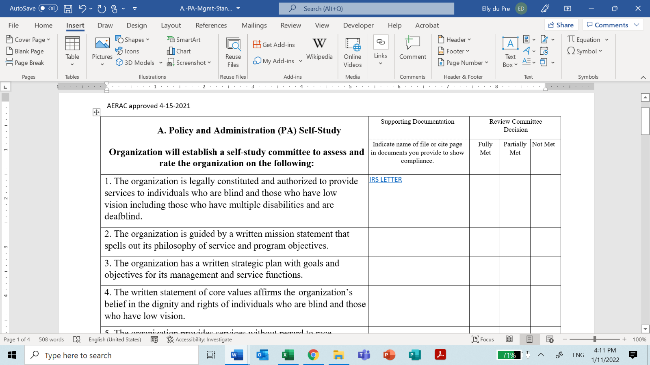
EVALUATING THE DOCUMENTATION

Slide 12
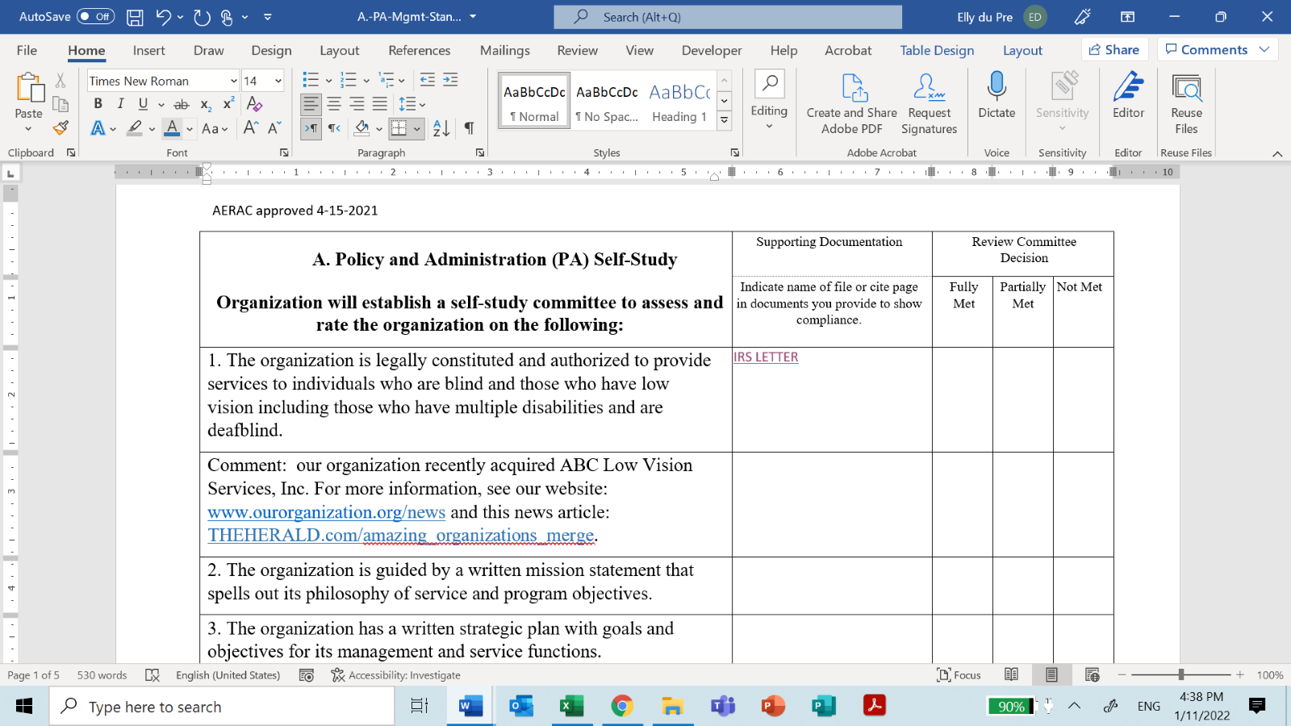
EVALUATING THE DOCUMENTATION

Slide 13
EVALUATING THE DOCUMENTATION
Part 2
The organization/school should provide links to specific
pages, or to the exact web address that provides the
evidence of compliance with the standard.
It should be clear where to look:
Reviewers should not have to read a lengthy document.
Reviewers should not have to search through a whole
website to find the documentation needed.

Slide 14
PAUSE…FOR REALITY CHECK
It’s OK if a reviewer finds evidence that applies to one standard, while looking for documentation on another one.
REMEMBER…If you find what you need, that’s a good thing.
BUT don’t get lost in the weeds, playing “hide and seek.” The panel can request additional documentation if needed.

Slide 15
EVALUATING THE DOCUMENTATION
Part 3
When the Reviewer finds the documentation and it does provide evidence of compliance:
  Reviewer uses the blank Standards Form provided by the AER Accreditation manager and places an X in the FULLY MET Column.

Slide 16
EVALUATING THE DOCUMENTATION
Part 3
  When the Reviewer cannot find the documentation, or it does not provide sufficient evidence of compliance:
  Reviewer uses the blank Standards Form and places an X in the PARTIALLY MET or NOT MET Column. OR…
  Reviewer makes a short note for themselves to discuss at next panel meeting, where panel may develop questions for further response from the Organization or School.

Slide 17
PANEL MEETINGS ON ZOOM
The AER Accreditation Manager shares the screen so everyone can see the Management or Program Form being discussed and the self-ratings provided by the organization or school.
The members use their notes from their individual blank forms to discuss each standard.
The accreditation manager puts an X in the appropriate column on a blank form, reflecting the consensus.

Slide 18
PANEL MEETINGS -- Part 2
If panel members need more information, this comment will be included on the consensus form which will be sent to the organization or school.
If panel members still cannot agree on a score, the OSAC Chair will decide.

Slide 19
TYPES OF DOCUMENTATION:
Examples for Management Standards
Each Management self study form lists Required
Documentation on the last page. The items on this list
should be provided as links.
A Self-Study Summary for Management also is required,
wherein the organization or school has the opportunity to
give a wider overview of accomplishments and plans, in
narrative form.

Slide 20
TYPES OF DOCUMENTATION:
Examples for Management Standards, cont’d
All Management standards are considered “absolute standards” and must be Fully Met for full accreditation to be awarded.
If one standard is only partially met, provisional accreditation may be awarded, provided that the organization/school commits to bringing that standard to fully met within one year.

Slide 21
TYPES OF DOCUMENTATION:
Examples for Program Standards, cont’d
As shown on the next slide, program standards with an asterisk (*) are considered “absolute standards” and must be Fully Met for accreditation to be awarded.

Slide 22
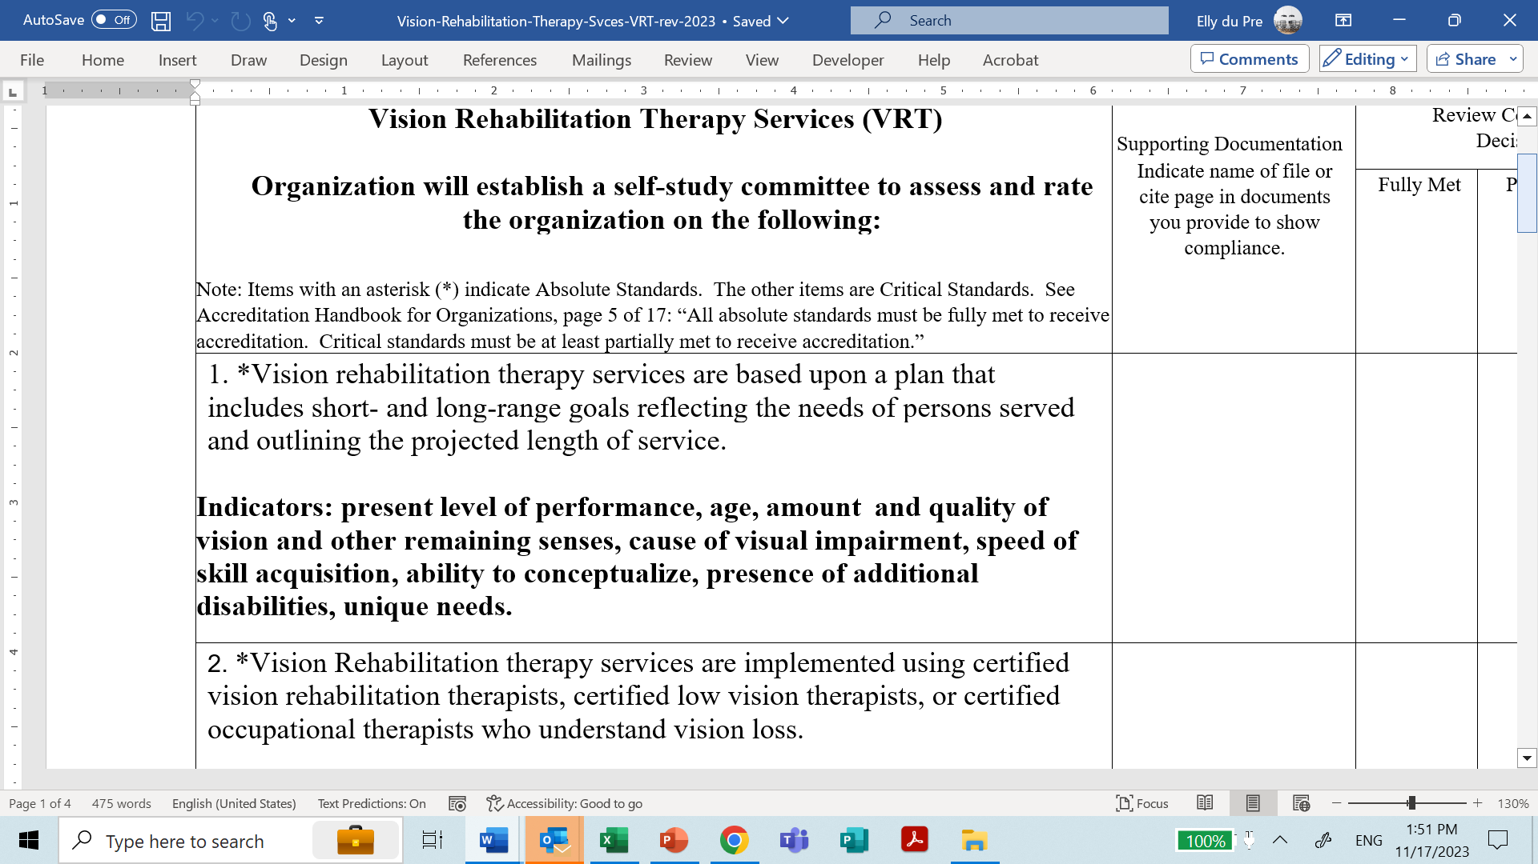



TYPES OF DOCUMENTATION:
Examples for Program Standards, cont’d

Slide 23
TYPES OF DOCUMENTATION:
Examples for Program Standards, cont’d
As seen on the next slide, there also are standards
without the asterisk, which are considered “critical
standards.”
For full accreditation, 95% of the total critical standards must
be fully met and the remainder at least partially met. The
Panel’s Report to OSAC will reference the remainder with a
recommendation they be brought to fully met and reported in the
Annual Update Report.

Slide 24
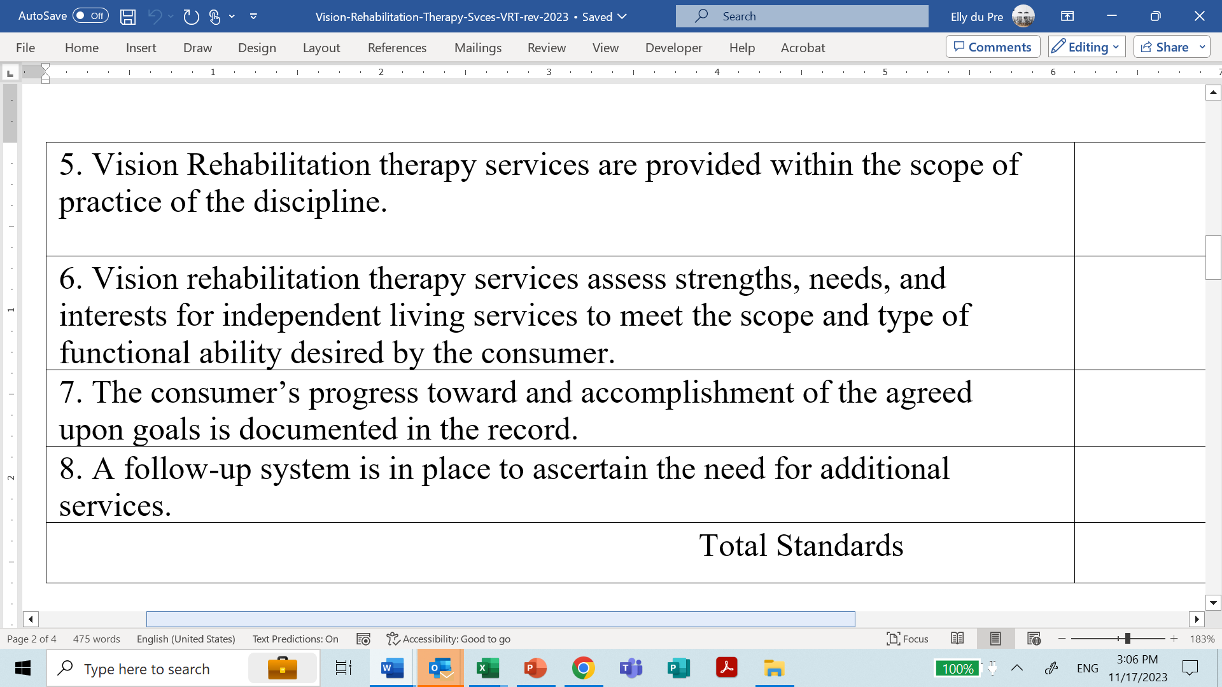
TYPES OF DOCUMENTATION:
Examples for Program Standards, cont’d

Slide 25
TYPES OF DOCUMENTATION:
Examples for Program Standards, cont’d
When only 85% - 94% of “critical standards” are fully
met, the panel may recommend provisional
accreditation.
OSAC will determine its own recommendation to
AERAC. If AERAC awards provisional
accreditation, the organization/school must commit
to fully meet those standards within a year of the
provisional accreditation.

Slide 26
INTERVIEWS
As illustrated on the next slide, an excel
spreadsheet is provided to the organization or
school, to facilitate scheduling.
Columns are provided for name, email address and
phone number for the individuals filling the roles of
CEO, Program Officer, Financial Officer and others,
plus 2 board members and 2 consumers.

Slide 27
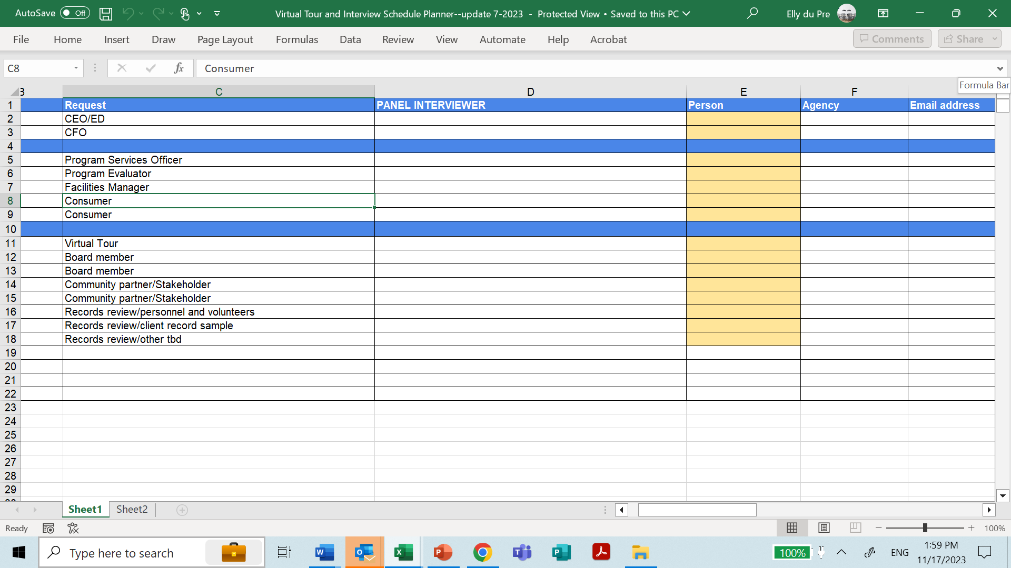

Slide 28
SCHEDULING INTERVIEWS
Interviews are conducted AFTER all of the submitted materials
have been reviewed and initial scoring has been completed on
Management and Program standards.
In panel meetings, the reviewers choose who they want to
interview based on the organization/school’s interview
scheduler.

Slide 29
SCHEDULING INTERVIEWS
Each reviewer finds a mutually convenient time to conduct the
interview, usually by telephone. If a zoom interview is
preferable, the accreditation manager can arrange it.
Group interviews can be scheduled if so desired.
Typical time frames for interviews:
Administrators: 30 - 45 minutes
Board Member/collateral agency: 30 minutes
Students/Consumers: 15 minutes

Slide 30
INTERVIEW QUESTIONS ARE
PROVIDED BY AER
Aer provides a template with the standard questions for each interview.
The panel may supplement the standard questions on the list based both on their deliberations and on information gleaned from the recordings of the organization/school’s public forums or consumer advisory board meetings.
The recordings of the public forums are required to be included in the organization/school’s accreditation materials.

Slide 31
VIRTUAL TOUR
The accreditation manager coordinates a mutually agreeable
date and time for the virtual tour. Prior to the tour, the manager
arranges a “dry run” with the organization or school to share
,
tips on panning, orienting the panel as they see the
buildings and grounds, accessibility and safety features,
classroom resources and other features related to the
standards.

Slide 32
PREPARING THE PANEL’S REPORT
After the virtual tour and interviews, the review panel prepares their findings using the OSAC Review Team Recommendation form.
The panel may provide the following optional feedback:
  Collegial Advice: non-binding suggestions for improvement related to compliance with the standards;
  Recognition of exemplary or innovative practices relative to the standards.

Slide 33
WRAPPING UP – THE FINAL STEPS
OSAC reviews the panel’s report, prepares its own recommendation, and sends it to AERAC for the final decision.
AERAC renders its decision.
The Accreditation Manager sends a letter to the organization/school with the decision. When full accreditation is awarded, the letter includes a certificate, the AERAC logo for the website, and a sample press release.

Slide 34
Late Breaking Updates and Questions
Stay in touch: EMAIL: ACCREDITATIONINFO@aerbvi.ORG

